Slide 1
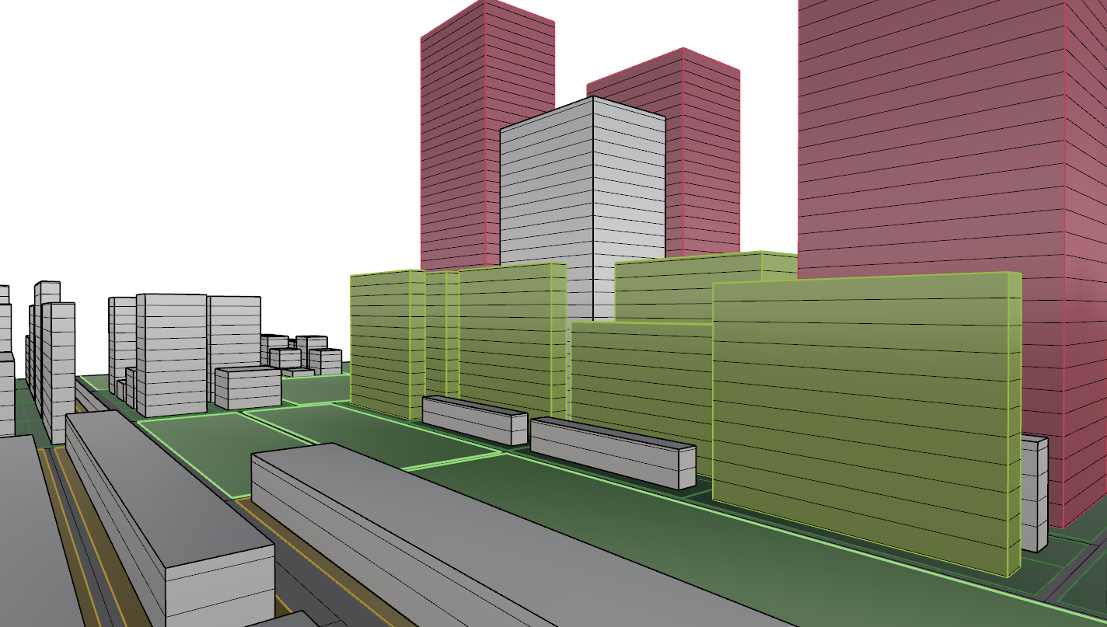
URBAN GENERATOR
R25
R8
C12
CODE2256

Slide 2
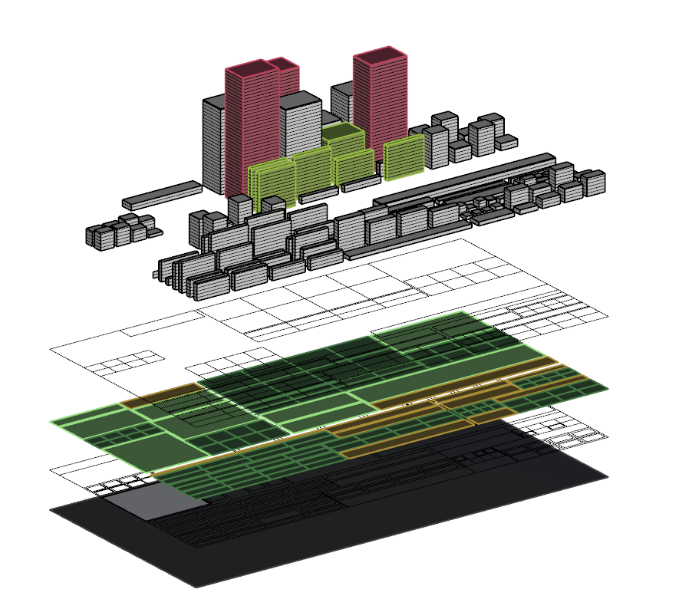
urban framework
buildings
plots
urban blocks
road network
precinct

Slide 3
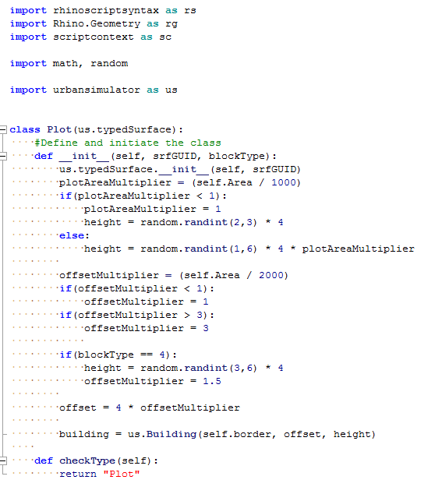

Slide 4
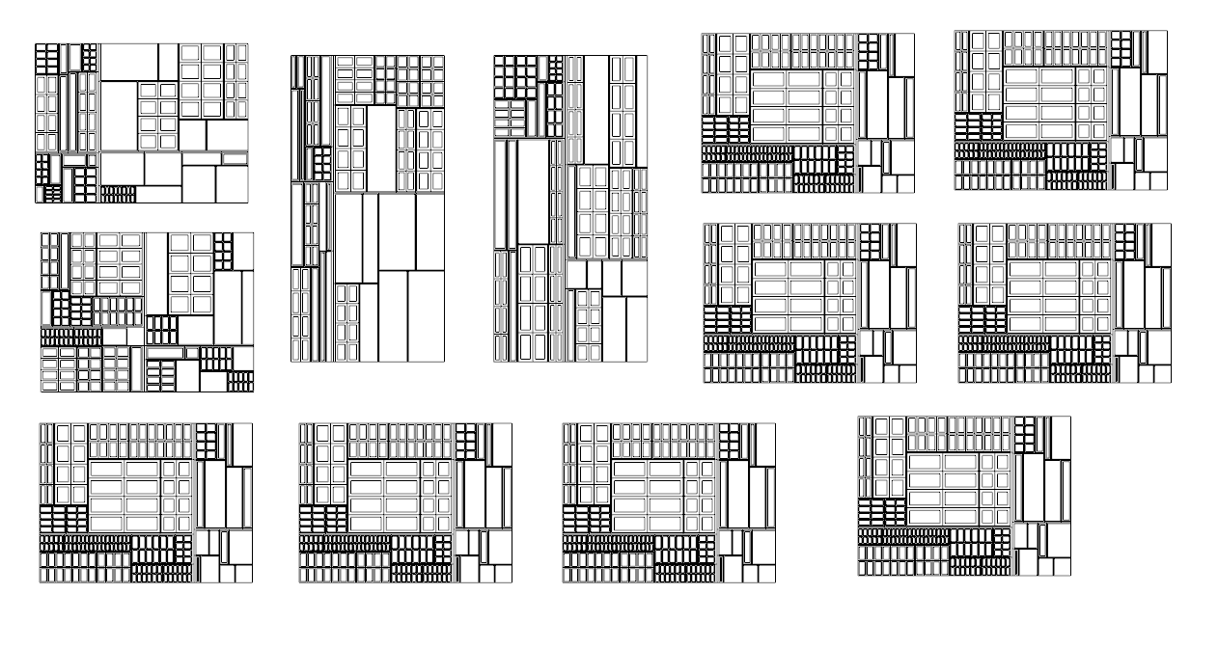
generative design

Slide 5
Road
NETWORK
Road
NETWORK
Road
NETWORK
Road
NETWORK

Slide 6
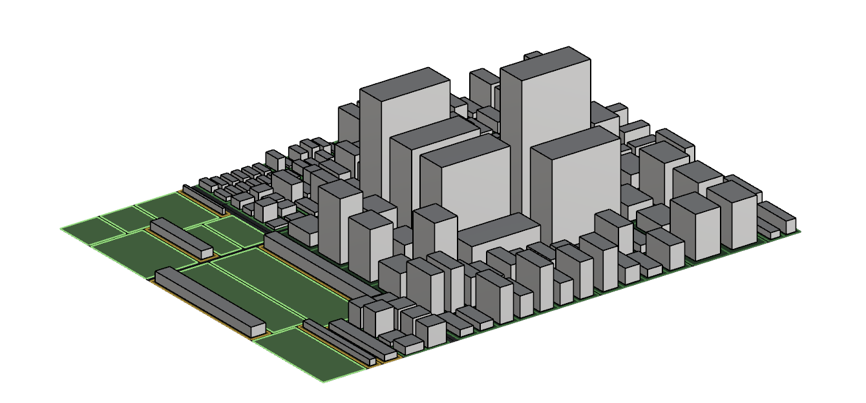
variation 232
#buildings: 52
#total floor area: 1,522m2
#total population: 10,252
% Public Space: 32%
R:C:P:G
30:40:15:15

Slide 7
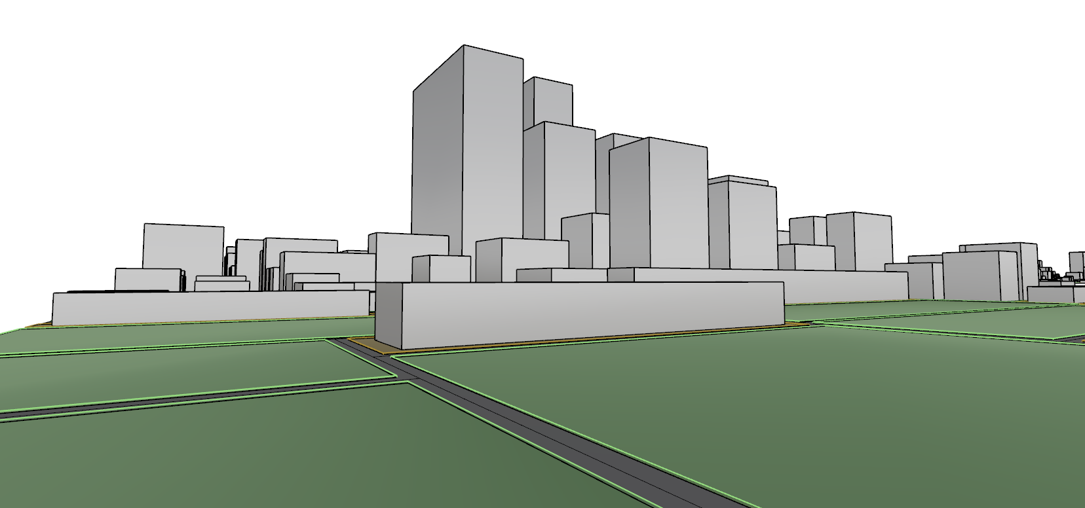
variation 232
#buildings: 52
#total floor area: 1,522m2
#total population: 10,252
% Public Space: 32%

Slide 8
variation 232
#buildings: 52
#total floor area: 1,522m2
#total population: 10,252
% Public Space: 32%

Slide 9
variation 232
#buildings: 52
#total floor area: 1,522m2
#total population: 10,252
% Public Space: 32%

Slide 10
variation 232
#buildings: 52
#total floor area: 1,522m2
#total population: 10,252
% Public Space: 32%

Slide 11
variation 232
#buildings: 52
#total floor area: 1,522m2
#total population: 10,252
% Public Space: 32%

Slide 12
variation 232
#buildings: 52
#total floor area: 1,522m2
#total population: 10,252
% Public Space: 32%

Slide 13
variation 232
#buildings: 52
#total floor area: 1,522m2
#total population: 10,252
% Public Space: 32%

